Slide 1
CPE 404
Computer Hardware Design
Dr Osama Hosameldeen
Spring 2021
Lecture 4
Decoders and Multiplexers

Slide 2
Topics
Decoders
  Combinational circuit Implementation
Encoders
  Priority Encoders
Multiplexers
  Combinational Circuit Implementation
Demultiplexers
Notes:
School of Engineering

Slide 3
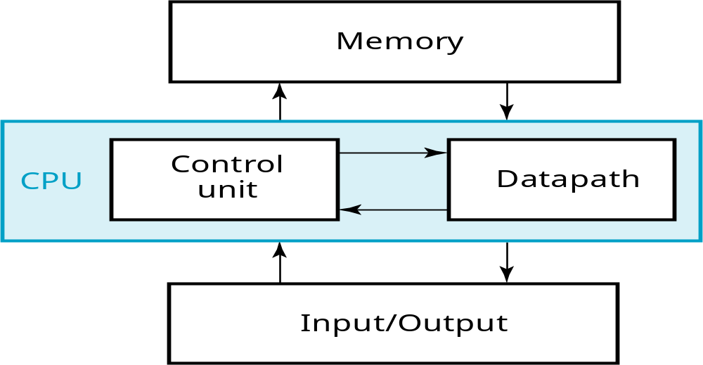
Central Processing Unit (CPU)
Data/Instructions/code
All in 01010010010
clock
Any CPU consists of two main parts:
  Datapath Unit: Arithmetic/Logic Operation
  Control Unit: Sends control signals to datapth to perform certain operations.
Notes:
School of Engineering
Answer: Part of specification for a PC is in MHz. What does that imply? A clock which defines the discrete times for update of state for a synchronous system. Not all of the computer may be synchronous, however.

Slide 4
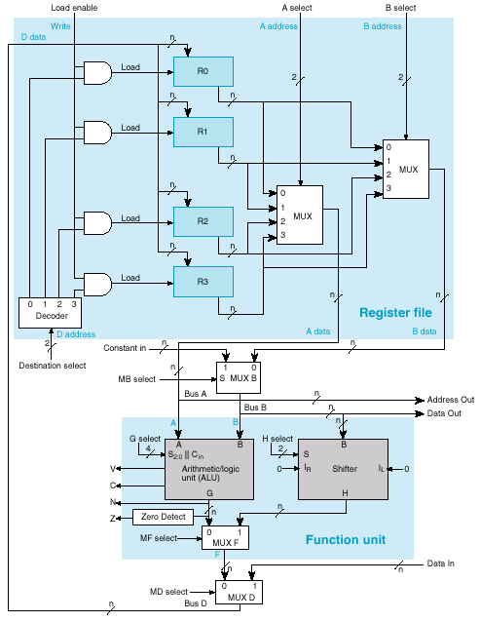
Decoders and Multiplexors
CPU Datapath
Decoders and Multiplexors are important components and fundamental circuits that are found in any Central Processing Unit (CPU)
Multiplexors are used to select certain registers to act as operands (inputs) to the Arithmetic/Logic Unit
Decoders are used to enable registers to write the results back into the registers.
Notes:
School of Engineering

Slide 5
Decoders

Slide 6
Devices on a Bus
Assume we have 4 devices that needs to put its data on a Bus
Only one device has to be active at a time (i.e. writes info on the bus)!
4 control signals “wires” from the Control Unit are needed to enable each device
If more devices are to be attached to the bus then we will need many more wires!!
Control
Unit
Enable
Device #0
Disable
Device #1
Disable
Device #2
Disable
Device #3
BUS

Slide 7
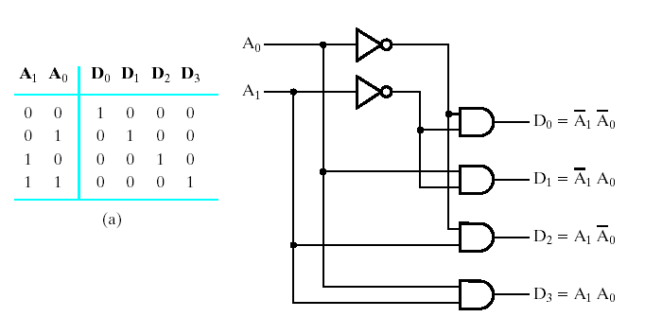
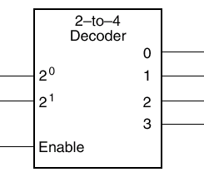
Address Decoding
Truth Table
4 devices need to write data to the Bus
Only one device has to be active at a time!
But! only 2 wires available from control unit
Control
Unit
Device #0
1
0
0
1
0
1
Device #1
0
0
0
0
0
0
Device #2
Device #3
BUS

Slide 8
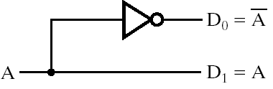
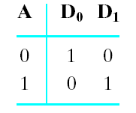
Decoders
Are circuits with n inputs and 2^{n} outputs
Drives high the output corresponding to binary code of input
Several Applications: Address Decoding, …
D₀
A
D₁

Slide 9
2-to-4 Line Decoder
Notice they are minterms
Plane of AND Gates
Inputs
Outputs

Slide 10
Other Decoders
  Examples:
  3-to-8 Decoder
  4-to-16 Decoder
    Binary to Octal,
    Binary to Hex, e.t.c
3-to-8
Line
Decoder
4-to-16
Line
Decoder
3
8
4
16

Slide 11
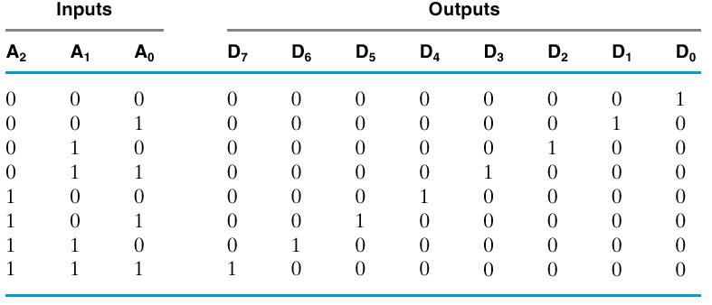
Truth Table, 3-to-8 Decoder
  Example: Binary to Octal, Binary to Hex, e.t.c
    Binary to Octal,
Notice they are minterms
A₀
3-to-8
Line
Decoder
A₁
A₂

Slide 12
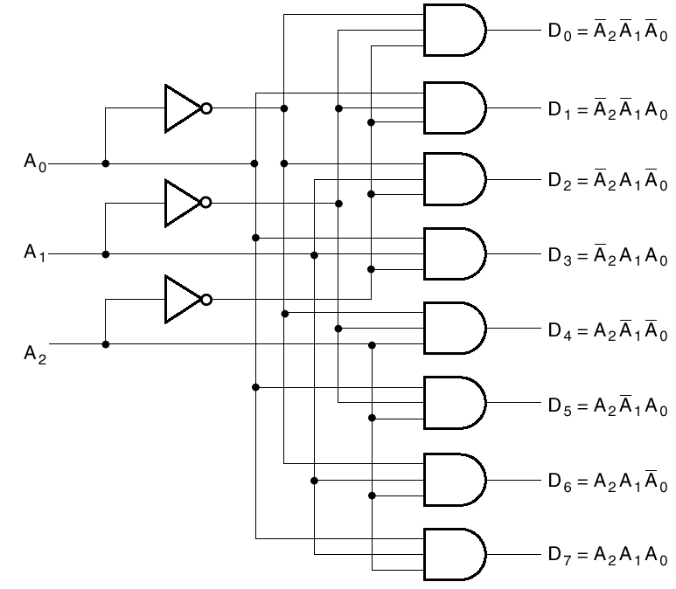
3-to-8 Line Decoder Schematic

Slide 13
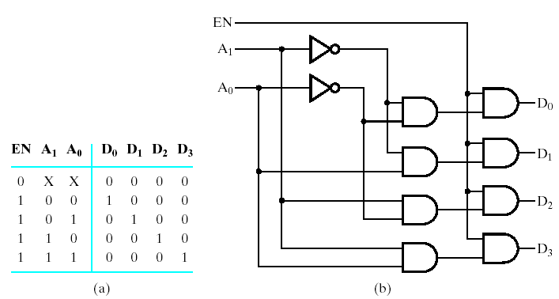
2-to-4 with Enable
Why use an Enable?

Slide 14
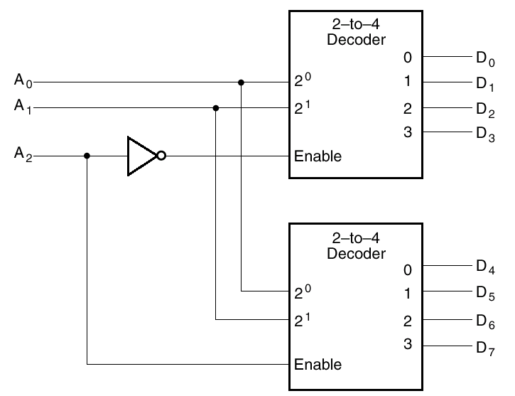
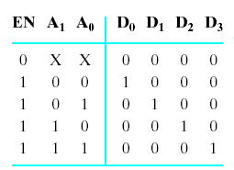
Enable Used for Expansion
A2
A1
A0
0
0
0
A 3-to-8 Decoder can be realized using two
2-to-4 line decoders with an enable
0
0
1
0
1
0
0
1
1
1
0
0
1
0
1
1
1
0
1
1
1
0
1
1
0
0
1

Slide 15
Usage for Decoders
Binary to Octal/Hex converters.
  Selecting memory banks, for example 4 memory banks can be selected individually using 2 address lines.
Implementing logic circuits!
Decoders are used in Micro Computer Interfacing for Keyboard and Display applications.

Slide 16
Address Decoding
CPU
Memory Bank #1
Memory Bank #2
Memory Bank #3
Memory Bank #4

Slide 17
Decoders: Logic Implementation

Slide 18
Decoders as General-purpose
Logic
n:2^{n} decoder implements any function of n variables
  With the variables used as control inputs
  Enable inputs tied to 1 and
  Appropriate minterms summed to form the function
Decoder generates appropriate
minterm based on control signals
(it "decodes" control signals)
Notes:
School of Engineering

Slide 19
Decoders as General-purpose
Logic
Example: Implement the following Boolean functions
  S(A₂,A₁,A₀) = SUM(m(1,2,4,7))
  C(A₂,A₁,A₀) = SUM(m(3,5,6,7))
Since there are three inputs, we need a 3-to-8 line decoder.
The decoder generates the eight minterms for inputs A₀,A₁,A₂
We choose only the minterms that we need for a function (S) or (C)
An OR GATE forms the logical sum minterms required.
Notes:
School of Engineering

Slide 20
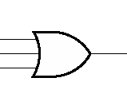
Decoders as General-purpose
Logic
  S(A₂,A₁,A₀) = SUM(m(1,2,4,7))
S
Notes:
School of Engineering

Slide 21
Decoders as General-purpose
Logic
A Single Decoder can implement both “S” and “C” with two OR Gates
  C(A₂,A₁,A₀) = SUM(m(3,5,6,7))
C
Notes:
School of Engineering

Slide 22
Example
F₁ = A' B C' D + A' B' C D + A B C D
F₁(A,B,C,D) = SUM(m(3,5,15))
Therefore, we will need a 4-to-16 line decoder
0 A'B'C'D'
1 A'B'C'D
2 A'B'CD'
3 A'B'CD
4 A'BC'D'
5 A'BC'D
6 A'BCD'
7 A'BCD
8 AB'C'D'
9 AB'C'D
10 AB'CD'
11 AB'CD
12 ABC'D'
13 ABC'D
14 ABCD'
15 ABCD
F1
4:16
DEC
Enable
Need to show that
variable A (MSB) needs
to be connected to MSB
of the Decoder
2³
2²
2¹
2⁰
A
B
C
D
Notes:
School of Engineering

Slide 23
Encoders

Slide 24
Encoder
Encoder is the opposite of decoder
  2^{n} inputs (or less – maybe BCD in)
  n outputs
Examples:
  Octal to binary conversion
  Hexadecimal to binary conversion

Slide 25
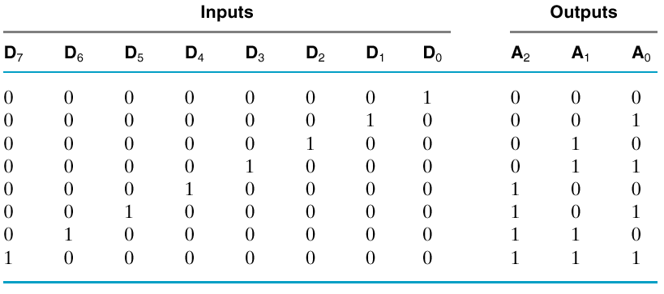
Octal to Binary Encoder
You can think of the inputs as the 8 Octal digits
Only one input is active at a time

Slide 26
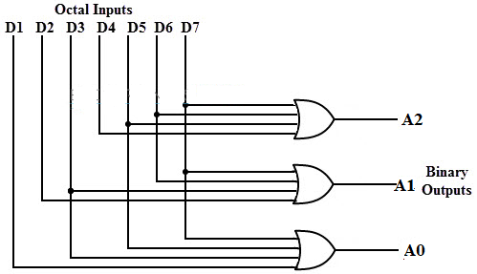
Design of Encoder
A₀ = D₁ + D₃ + D₅ + D₇

Slide 27
Multiplexors

Slide 28
Multiplexer (or Mux)
Selects one of a set of inputs to pass on to output
For Every 2^{n} inputs we need n select lines
Applications: Useful for choosing from sets of data
  Memory or register to ALU
In0
In1
Out
MUX
In2
In3
S₀
S₁

Slide 29
Multiplexors
The Multiplexor in the register file allows one of the four registers R0, R1, R2, R3 to move its contents to the Function Unit
The Multiplexor in the Function Unit allows the user to choose between the ALU and Shifter to move data back to the Register File.
Notes:
School of Engineering

Slide 30
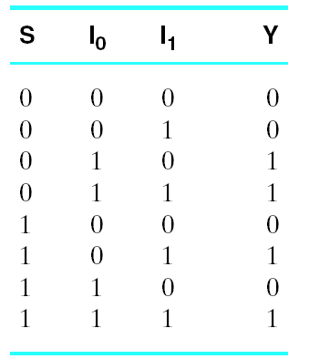
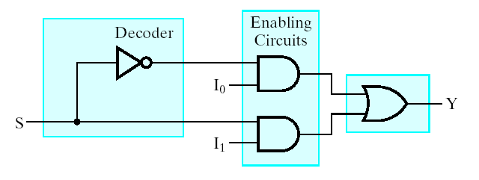
2-Input Multiplexer
Structure:
A Plane of AND Gates
Followed by an OR Gate

Slide 31
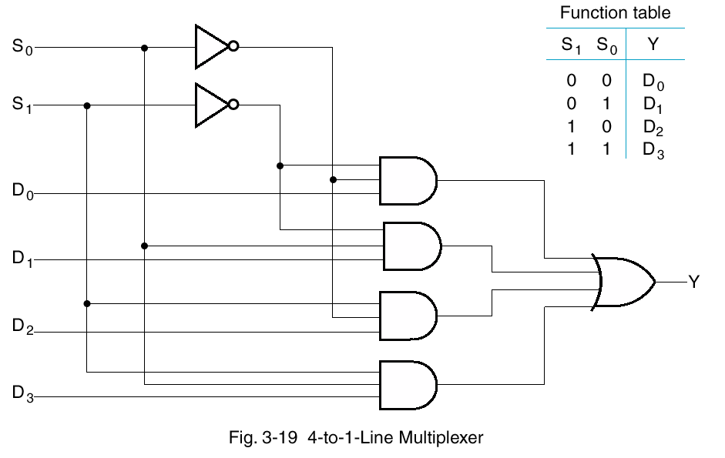
4-to-1 Line Multiplexer

Slide 32
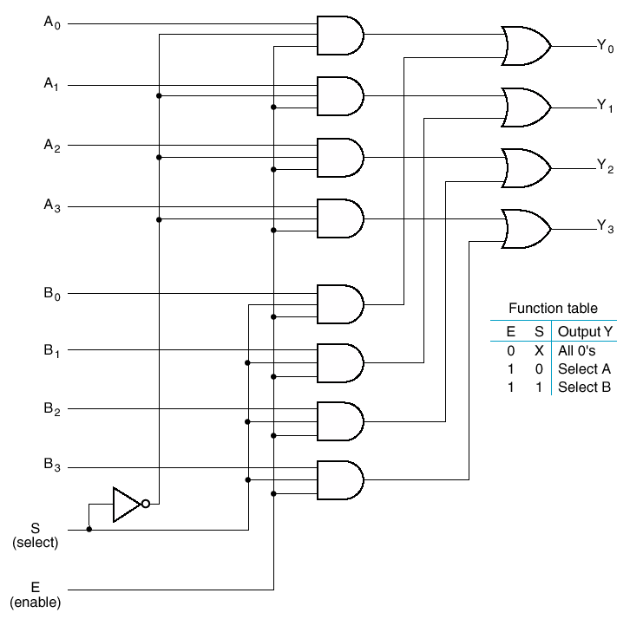
Quad 2-to-4 Line Mux
Select one set of 4 lines

Slide 33
Multiplexors: Logic Implementation

Slide 34
Implementing Logic
2^{n}:1 multiplexer implements any function of n variables
  With the variables used as control inputs and
  Data inputs tied to 0 or 1
  In essence, a lookup table
Example: F(A,B) = m0 + m2
= A'B' + AB’
A | B | F
0 | 0 | 1
0 | 1 | 0
1 | 0 | 1
1 | 1 | 0

Slide 35
Muxes as General-purpose Logic
2^{n}:1 multiplexer implements any function of n variables
  With the variables used as control inputs and
  Data inputs tied to 0 or 1
  In essence, a lookup table
Example: F(A,B,C) = m0 + m2 + m6 + m7
= A'B'C' + A'BC' + ABC' + ABC
A | B | C | F
0 | 0 | 0 | 1
0 | 0 | 1 | 0
0 | 1 | 0 | 1
0 | 1 | 1 | 0
1 | 0 | 0 | 0
1 | 0 | 1 | 0
1 | 1 | 0 | 1
1 | 1 | 1 | 1
1
0
1
0
0
0
1
1
0
1
2
3
4
5
6
7
8:1 MUX
F
S2
S1
S0
A
B
C
Notes:
School of Engineering

Slide 36
Muxes as General-purpose Logic
2^{n-1}:1 mux can implement any function of n variables
  With n-1 variables used as control inputs and
  Data inputs tied to the last variable or its complement
Example:
  F(A,B,C) = m0 + m2 + m6 + m7
  = A'B'C' + A'BC' + ABC' + ABC
Not Optimized
How to use a 4:1 MUX Instead?
1
0
1
0
0
0
1
1
0
1
2
3
4
5
6
7
A B C F
0 0 0 1
0 0 1 0
0 1 0 1
0 1 1 0
1 0 0 0
1 0 1 0
1 1 0 1
1 1 1 1
Use inputs A, B as the selection lines for the 4:1 MUX since we will only have two selection lines
Find a relationship between C (the third input) and F
F
8:1 MUX
S2
S1
S0
A
B
C
Notes:
School of Engineering

Slide 37
Muxes as General-purpose Logic
2^{n-1}:1 mux can implement any function of n variables
  With n-1 variables used as control inputs and
  Data inputs tied to the last variable or its complement
Example:
  F(A,B,C) = m0 + m2 + m6 + m7
  = A'B'C' + A'BC' + ABC' + ABC
Not Optimized
Optimized
How to use a 4:1 MUX Instead?
1
0
1
0
0
0
1
1
0
1
2
3
4
5
6
7
A B C F
0 0 0 1
0 0 1 0
0 1 0 1
0 1 1 0
1 0 0 0
1 0 1 0
1 1 0 1
1 1 1 1
C'
C'
0
1
C'
C'
0
1
0
1
2
3
F
F
8:1 MUX
4:1 MUX
S1
S0
S2
S1
S0
A
B
A
B
C
Notes:
School of Engineering

Slide 38
Demultiplexors

Slide 39
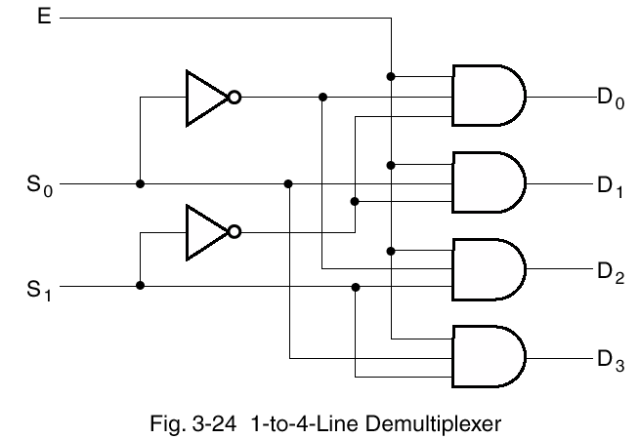
Demultiplexer
Takes one input out to one of 2^{n} possible outputs

Slide 40
Priority Encoders

Slide 41
Revisiting Encoder!! Why?
Only ONE input is allowed to be active at a time!

Slide 42
What’s the Problem?
What if D3 and D6 both high?
Simple OR circuit will set A to 111
This is an issue!!!!
Solution?

Slide 43

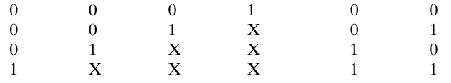
Priority Encoder
Chooses one with highest priority
  Largest number, usually
“X” in input == 0 or 1
  compact Truth Table

Slide 44
Unfolding the Compact Truth Table
D3 | D2 | D1 | D0 | A1 | A0
0 0 0 1 0 0
0 0 1 0 0 1
0 0 1 1 0 1
What if all inputs are zero?

Slide 45
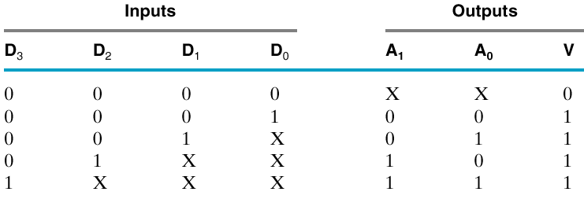
Need Another Output!
A Valid Output!

Slide 46
Expanded Truth Table (A0)
D3 | D2 | D1 | D0 | A0
0 | 0 | 0 | 0 | X
0 | 0 | 0 | 1 | 0
0 | 0 | 1 | 0 | 1
0 | 0 | 1 | 1 | 1
0 | 1 | 0 | 0 | 0
0 | 1 | 0 | 1 | 0
0 | 1 | 1 | 0 | 0
0 | 1 | 1 | 1 | 0
1 | 0 | 0 | 0 | 1
1 | 0 | 0 | 1 | 1
1 | 0 | 1 | 0 | 1
1 | 0 | 1 | 1 | 1
1 | 1 | 0 | 0 | 1
1 | 1 | 0 | 1 | 1
1 | 1 | 1 | 0 | 1
1 | 1 | 1 | 1 | 1
D₁D₀
D₃D₂
00
01
11
10
00
x | 0 | 1 | 1
0 | 0 | 0 | 0
1 | 1 | 1 | 1
1 | 1 | 1 | 1
01
11
10
A₀ = D₃ + D₂D₁

Slide 47
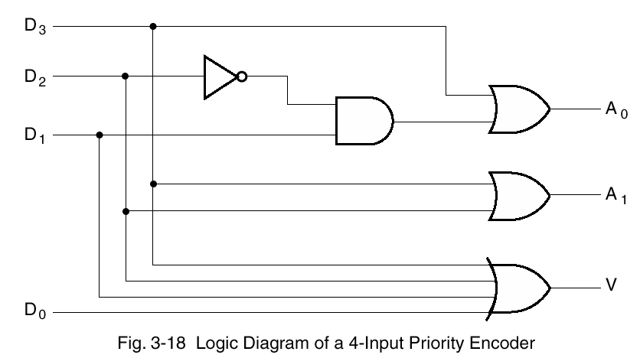
Valid is OR of all inputs

Slide 48
Lecture End

